Slide 1
Year 1 and 2 Parent Workshop
Year 1:
Mrs Baskerville = s.baskerville@chalkridgepri.hants.sch.uk
Mrs Keat = n.keat@chalkridgepri.hants.sch
Year 2:
Miss Hare = k.hare@chalkridgepri.hants.sch.uk
Miss O’Brien = s.o’brien@chalkridgepri.hants.sch.uk

Slide 2
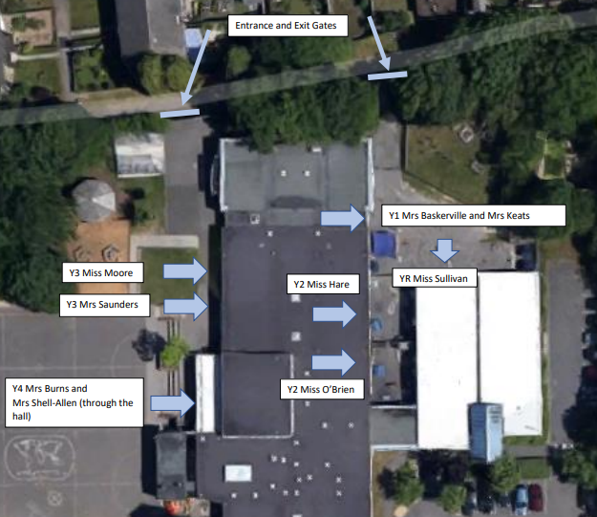
Drop off and Pick up
The gates are opened at 8:30am.
Classroom doors are opened at 8:40am. Children should arrive between 8:40am-8:50am.
If children arrive after 8:50am they need to go through the office and will be marked as late.
Children to be picked up at 3:10pm at the same place as they were dropped off.
Notes:
RSA

Slide 3
School Uniform
Navy-blue jumper/sweatshirt or cardigan (no hooded tops);
Light blue polo shirt, shirt or blouse;
Grey trousers, skirt or pinafore dress (summer cotton dress in blue and white);
White, navy-blue or grey socks/tights;
Conventional outdoor shoes in dark colours (conventional sandals may be worn in the summer);
Hair longer than shoulder length tied up in plain coloured hairbands.

Slide 4
PE School Uniform
Light blue t-shirt;
Navy blue PE briefs, shorts, jogging bottoms or wrap over games skirt;
Light blue fleece or sweatshirt (no hooded tops);
Trainers or plimsolls for outdoor PE.
Safety Notes
Earrings should be removed during all PE activities (taped if newly pierced).
All indoor PE in bare feet.
Hair longer than shoulder length tied up in plain coloured band.
No hooded tops allowed.

Slide 5
Equipment Needed
Your children will not be required to bring their own pencil
cases or equipment as this will be provided for them.
PE kit will be need to be worn into school on days where PE is taught.
Year 1 – Tuesday and Friday
Year 2H – Tuesday and Wednesday
Year 20 – Tuesday and Friday
Please note, children are not allowed to bring toys or fiddle toys from home. Fiddle toys will be provided where needed.

Slide 6
Reading
Regularly listening to your child read and reading to your child will
benefit them.
Through reading, children can:
Develop their sense of self
Improve emotional literacy
Develop empathy
“A love of reading is the biggest indicator of future academic success.”
OECD (The Organisation for Economic Co-operation and Development)

Slide 7
Reading at home
Reading Records
Every time you read with your child at home, please record in their reading record.
Reading Raffle
Read at home with your child as often as possible, or at least 5 x a week.
5 x a week = entered into reading raffle at the end of every month.
25 reads
Every 25 reads that are recorded in your child’s reading record, they will receive a certificate.
Aim for 200 or more!

Slide 8
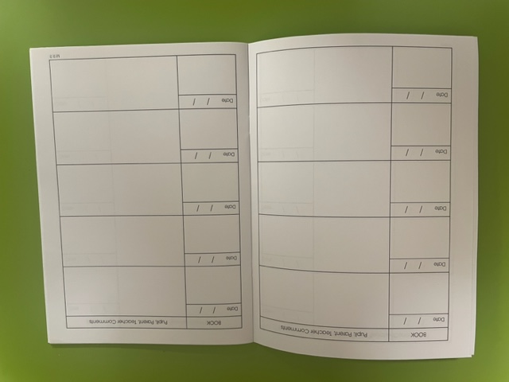
Reading Records
Date
Name of book/Page no.
Comments

Slide 9
Key Reading Texts
We ensure that the children are exposed to a variety of genres and text types throughout the year. This can be through: Reading practice sessions, English learning journey books, topic books and story time.

Slide 10
Reading and phonics in school
Readi
Reading Practice
This will continue in exactly the same way as in Year R and Year 1.
They will read the book 3x in school – once for decoding, once for prosody and once for comprehension.
An e book will be issued to be read at home.
Phonics
Children will be taught a phonics lessons daily.

Slide 11
Year 1
Our team…

Slide 12
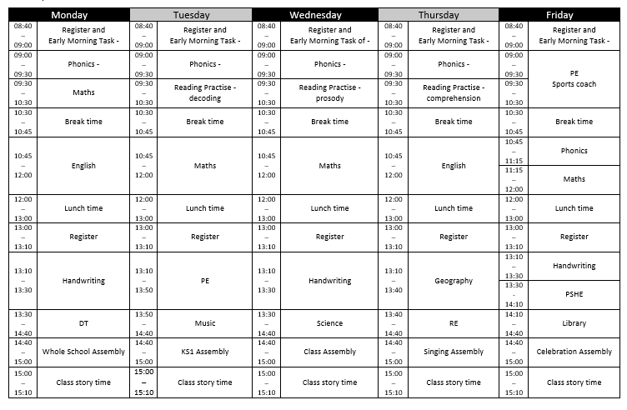
Timetable

Slide 14
Home Learning

Slide 15
Year 2
Our team…

Slide 16
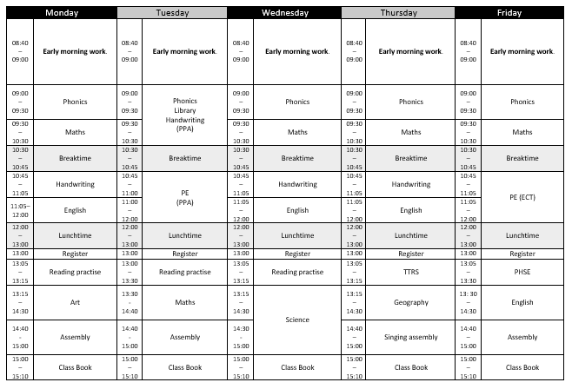
Year 2

Slide 17
Our Autumn Curriculum Information Overview

Slide 18
Home Learning

Slide 19
Each child in Year 2 will receive a login to a fun app called NumBots.
It helps children to master their addition, subtraction and number bonds knowledge in a fun, gamified way.
It is expected in Year 2 that each child will use the app at least 3 times a week.
This is the sister company for TTRS.

Slide 20
Key Dates This Term 2024-2025
Numbots Rockstar Day Friday 13th September
Photographer in school on Thursday 19th September
Climate Unity morning on Wednesday 25th September
School Census Day on Thursday 3rd October (no packed lunch day)
Home Learning due in on 21st/22nd October
INSET day Monday 4th November
Parents Evenings on Inset Day on Tuesday 5th and Thursday 7th of November.

Slide 21
Attainment 2023-2024
O:\Head Teacher\ASSESSMENT\Assessment 23-24\EYFS and Phonics Perspective Lite.docx
O:\Head Teacher\ASSESSMENT\Assessment 23-24\MTC Benchmark (Keypas).docx
O:\Head Teacher\ASSESSMENT\Assessment 23-24\Key Stage 2 comparative report 2024.docx

Slide 22
School Development Plan 2023-2024
Quality of Teaching and Learning
Ensure all year group attainment in the core subjects is broadly in line with the Local Authority and National data with a sharper focus on the end of Year 2 and Year 6.
Improve the consistency of high-quality teaching strategies with a sharper focus on maths and writing.
Ensure children are being taught a well sequenced, broad and balanced foundation curriculum so they know more, remember more and can do more.
Leadership and Management (including governance)
Improve the effectiveness of subject leaders so they make a greater contribution to school improvement.

Slide 23
School Development Plan
2024 – 2025
Priority I Quality of Education
Develop recall and retention of knowledge in maths to increase the proportion of pupils achieving the expected standard and greater depth.
Priority 2 Quality of Education
Increase the application of correct spelling, punctuation and grammar to ensure more children are working at EXS and GDS in writing.
Priority 3 Leadership and Management
Develop the implementation and impact of the foundation curriculum to ensure that it has golden threads which promote the cultural capital of all Chalk Ridge pupils.
Priority 4 Leadership and Management
Ensure that the school budget is fit for purpose, effectively managed to meets the needs of the children and is not in deficit at the end of the fiscal year.

Slide 24
Attendance – met national 94%
School Census – 3rd October 2024 (no packed lunches in KS1)
PTA – AGM is on Tuesday 1st October 24 6.30pm
Newsletter

